Slide 1
Lunch Order App
UI Examples

Slide 2
Login Screen
Lunch Ordering App
Login Name:
Login Password:
Log In
Forgot Password

Slide 3
Welcome Page
Navigation
Home
View Lunch Selector
Start Lunch Order
Get Lunch Total
Rate Lunch
View Ratings
Countdown Timer
Wheel of Restaurants
View Aggregate Ratings
Admin Login
Welcome!
Denny
Log Out
Notes:
Welcome page

Slide 4
Admin Page
Navigation
Home
View Lunch Selector
Start Lunch Order
Get Lunch Total
Rate Lunch
View Ratings
Countdown Timer
Wheel of Restaurants
View Aggregate Ratings
Admin Login
Administration Page
Admin
Log Out
Add User | Start User Order | View Order Hist. | View Log
Remove User | Cancel User Order | Change Tax rate
Edit User | Edit User Order | Change Tip amt.
View Users | Skip User Order
Notes:
Only accessible via Admin account
Abilities:
Add new user
Remove user

Slide 5
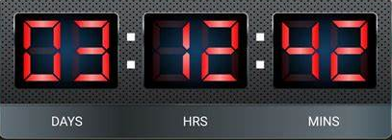
Nice to Have: Countdown Timer
Navigation
Home
View Lunch Selector
Start Lunch Order
Get Lunch Total
Rate Lunch
View Ratings
Countdown Timer
Wheel of Restaurants
View Aggregate Ratings
Admin Login
Time Until Next Lunch Order
Denny
Log Out

Slide 6
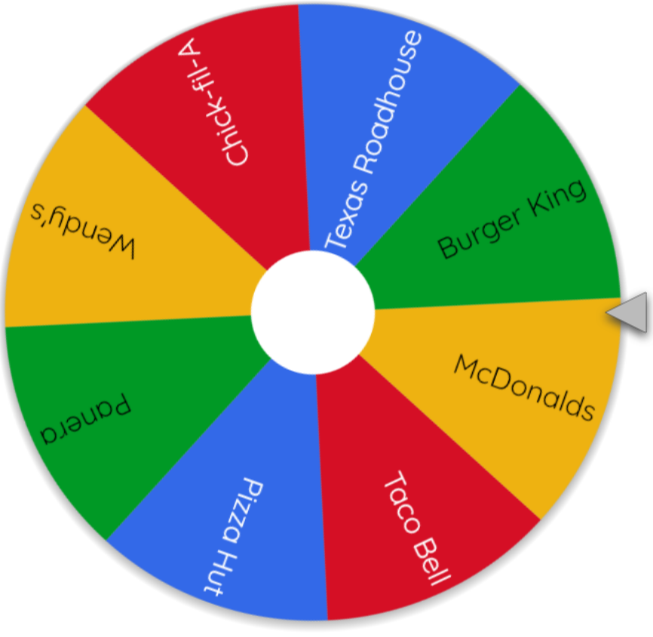
Nice to Have: Wheel of Restaurant Names
Navigation
Home
View Lunch Selector
Start Lunch Order
Get Lunch Total
Rate Lunch
View Ratings
Countdown Timer
Wheel of Restaurants
View Aggregate Ratings
Admin Login
Choose Random Restaurant
Denny
Log Out
Notes:
Wheel of Names | Random name picker

Slide 7
View Current Person Whose Turn To Order (if restaurant selected)
Navigation
Home
View Lunch Selector
Start Lunch Order
Get Lunch Total
Rate Lunch
View Ratings
Countdown Timer
Wheel of Restaurants
View Aggregate Ratings
Admin Login
View Current Lunch Selector
Denny
Log Out
Selector | Name | Chosen Restaurant
 | Hani
X | Chris | Olive Garden
 | Kris
 | Tammy
 | Emilio
 | Denny
 | Garren
Notes:
Show list of users and show who current person to select restaurant to order from

Slide 8
View Current Person Whose Turn To Order (if restaurant IS NOT selected)
Navigation
Home
View Lunch Selector
Start Lunch Order
Get Lunch Total
Rate Lunch
View Ratings
Countdown Timer
Wheel of Restaurants
View Aggregate Ratings
Admin Login
View Current Lunch Selector
Denny
Log Out
Selector | Name | Chosen Restaurant
 | Hani
X | Chris | None Selected
 | Kris
 | Tammy
 | Emilio
 | Denny
 | Garren
Notes:
Show list of users and show who current person to select restaurant to order from

Slide 9
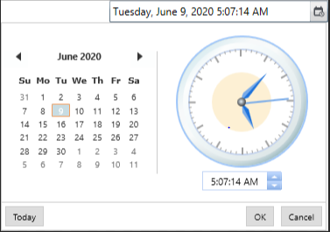
Person Whose Turn To Order Starting The Group Order
Navigation
Home
View Lunch Selector
Start Lunch Order
Get Lunch Total
Rate Lunch
View Ratings
Countdown Timer
Wheel of Restaurants
View Aggregate Ratings
Admin Login
Start New Lunch Selection
Denny
Log Out
Restaurant:
Garren’s Cantina
Order Deadline:
Start Order
Cancel Order
Notes:
Person who orders will type in name of restaurant and set a due date for all orders

Slide 10
Other Users Start Lunch Order Screen
Navigation
Home
View Lunch Selector
Start Lunch Order
Get Lunch Total
Rate Lunch
View Ratings
Countdown Timer
Wheel of Restaurants
View Aggregate Ratings
Admin Login
Start New Lunch Order
Denny
Log Out
Restaurant:
Garren’s Cantina
Order desc.:
Hot ham and cheese sub with fries and Coke
Order total:
$11.54
Submit Order
Notes:
All users will type in order and total for the chosen restaurant.

Slide 11
View Total & Pay
Navigation
Home
View Lunch Selector
Start Lunch Order
Get Lunch Total
Rate Lunch
View Ratings
Countdown Timer
Wheel of Restaurants
View Aggregate Ratings
Admin Login
Confirm Lunch Total
Denny
Log Out
Order total:
$11.54
Tax total:
$0.69
Fee total:
$3.00
Tip total:
$2.31
Grand total:
$17.54
Confirm Order

Slide 12
View Order totals for Person Whose Turn To Order (after restaurant selected)
Navigation
Home
View Lunch Selector
Start Lunch Order
Get Lunch Total
Rate Lunch
View Ratings
Countdown Timer
Wheel of Restaurants
View Aggregate Ratings
Admin Login
View Current Lunch Totals
Denny
Log Out
Name | Order Desc. | Total
Hani | Gyro fries and Coke | $12.56
Chris | Steak sandwich and tea | $13.42
Kris | Grilled chicken sandwich and protein shake | $20.10
Tammy | Grilled salmon and tea | $15.44
Emilio | Fried chicken sandwich and Sprite | $18.21
Denny | Shrimp Po’ Boy and tea | $18.66
Garren | Swedish meatballs, mashed potatoes and diet Coke | $15.96
Grand total:
$114.35
Notes:
Show list of users and show who current person to select restaurant to order from

Slide 13
Rate Lunch Order
Navigation
Home
View Lunch Selector
Start Lunch Order
Get Lunch Total
Rate Lunch
View Ratings
Countdown Timer
Wheel of Restaurants
View Aggregate Ratings
Admin Login
Rate Lunch Order
Denny
Log Out
How was your
Caesar Salad
From
Olive Garden
Rating:
Comments:
Caesar Salad was good but they forgot the croutons!
Notes:
User can rate order from 0 to 5 stars

Slide 14
View Previous Lunch Orders
Navigation
Home
View Lunch Selector
Start Lunch Order
Get Lunch Total
Rate Lunch
View Ratings
Countdown Timer
Wheel of Restaurants
View Aggregate Ratings
Admin Login
View Previous Lunch Orders
Denny
Log Out
Date | Restaurant | Order | Rating
June 8 | Hani’s Burgers | Hamburger and fries
June 15 | Denny’s Pizzaria | Pizza
June 22 | Emilio’s Gyros and More | Gyro
June 29 | Chris’s Steakhouse | Chicken Salad
July 6 | Tokyo | Sushi

Slide 15

Nice to Have: View Aggregate Lunch Order Ratings
Navigation
Home
View Lunch Selector
Start Lunch Order
Get Lunch Total
Rate Lunch
View Ratings
Countdown Timer
Wheel of Restaurants
View Aggregate Ratings
Admin Login
View Restaurant Lunch Order Rating
Denny
Log Out
 | Restaurant | Average Rating | Comments
 | Hani’s Burgers
 | Denny’s Pizzaria
 | Emilio’s Gyros and More
 | Chris’s Steakhouse
 | Tokyo

Slide 16
Nice to Have: View Aggregate Lunch Order Reviews
Navigation
Home
View Lunch Selector
Start Lunch Order
Get Lunch Total
Rate Lunch
View Ratings
Countdown Timer
Wheel of Restaurants
View Aggregate Ratings
Admin Login
View Restaurant Lunch Order Reviews
Denny
Log Out
Restaurant:
Garren’s Cantina
Date | Order | Review | Rating
June 8 | Gyro fries and Coke | Fries were cold
June 8 | Grilled chicken sandwich and protein shake | Protein shake was delicious!
June 8 | Grilled salmon and tea | Salmon was good but got unsweet tea
June 8 | Fried chicken sandwich and Sprite | The chicken sandwich was soggy but had good spices
July 6 | Shrimp Po’ Boy and tea | Shrimp po boy was amazing, will order again!
July 6 | Swedish meatballs, mashed potatoes and diet Coke | The meatballs looked under cooked
Notes:
The reviews are for all users who wrote review(s) for that restaurant

